Slide 1
Review of Protists…76

Slide 2
Contractile vacuole- a cell structure used to expel water that accumulates in certain unicellular organisms
Eyespot- organelle that has sensitivity to light
Flagellum- whiplike tail used for movement
Pseudopod- extension of the cytoplasm that forms when the cytoplasm extends out. Used for movement in amoeba
Cilia- tiny hairs used by the paramecium for movement

Slide 3
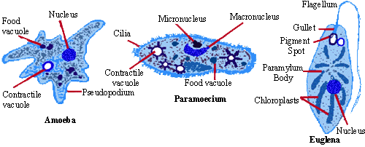
AMEOBA
Pseudopod for movement
Heterotrophs
Causes dysentery and malaria

Slide 4
Paramecium
Cilia for movement
Contractile vacuole
heterotrophs

Slide 5
EUGLENA
Flagella (tail) for movement
Eyespot
Autotroph and heterotroph
Has chloroplasts

Slide 6
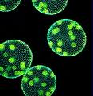
VOLVOX in Colonies
Unicellular but live in colonies, looking like multicellular
Autotrophs (has chloroplasts)

