Slide 1
Renewable or Nonrenewable Energy…68

Slide 2
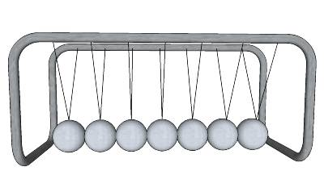
Kinetic Energy
Moving energy

Slide 3
Potential Energy
Stored energy
Roller Coaster

Slide 4
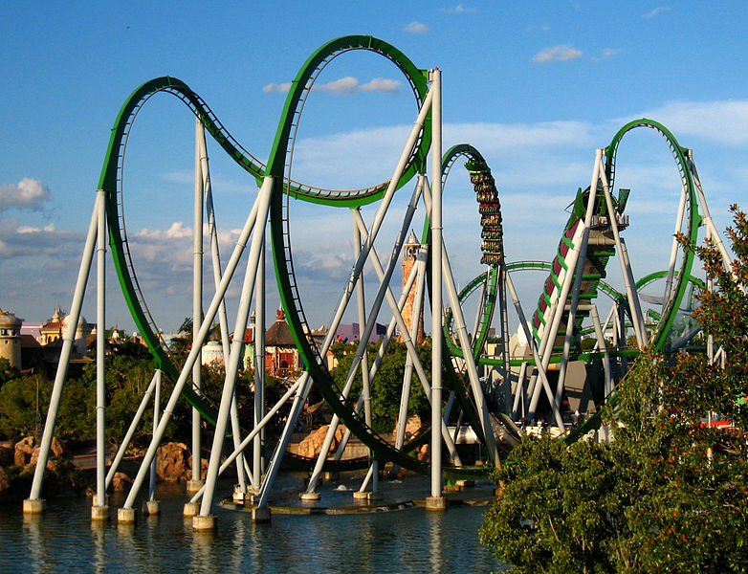
The Law of Conservation of ENERGY
energy cannot be created or destroyed (just changed)
some energy always turns to heat

Slide 5
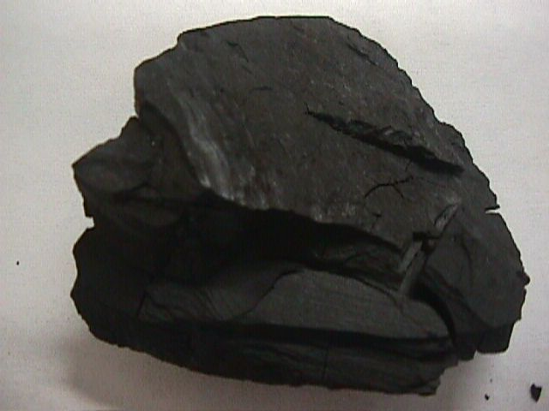
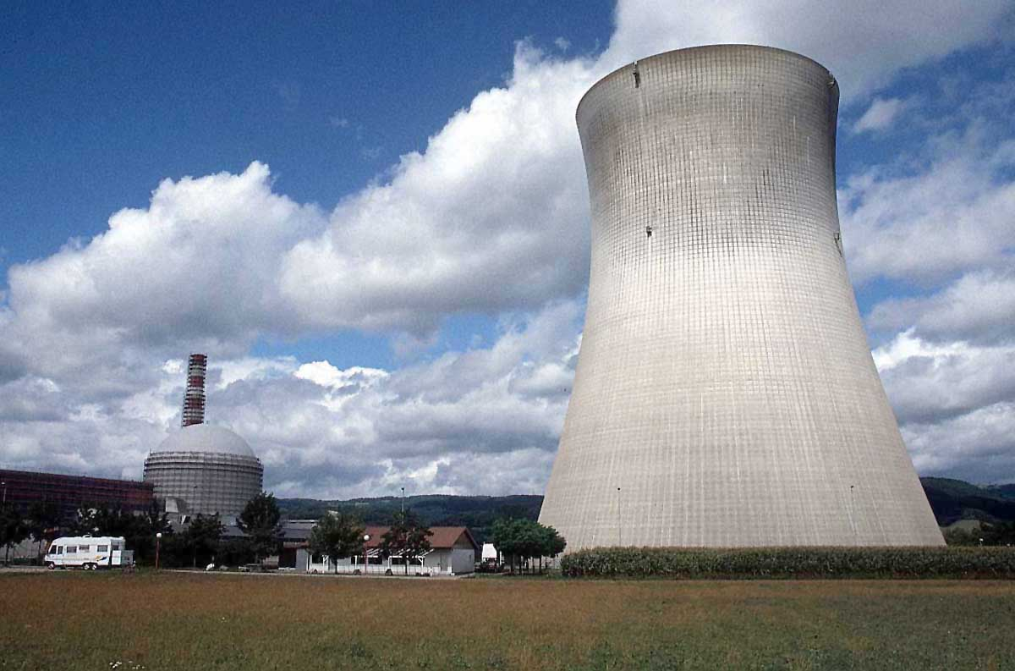
Nonrenewable resources
A natural resource that will run out or cannot be replaced in our lifetime

Slide 6
Examples:
Fossil fuels(oil, coal and gasoline)
Natural gas
Nuclear (uranium)

Slide 7
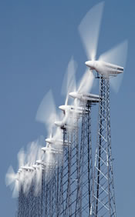
Renewable Resources
Natural resources that can be replaced in a short period of time.

Slide 8
Examples:
● Solar
● Geothermal
● Wind
● Biomass
● Water

Slide 9
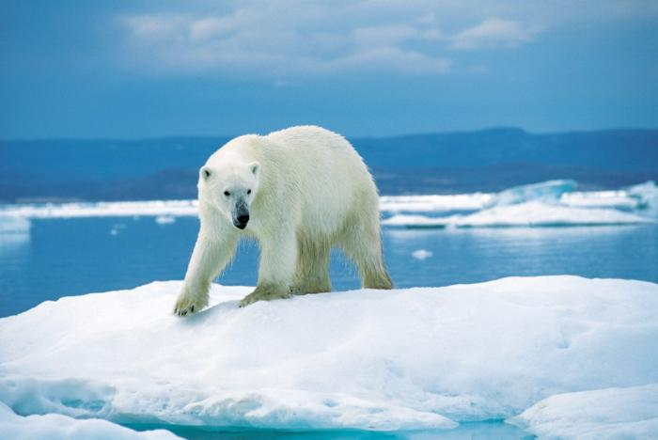
Conserving Energy

