Slide 2
Observations and Inferences…6

Slide 3
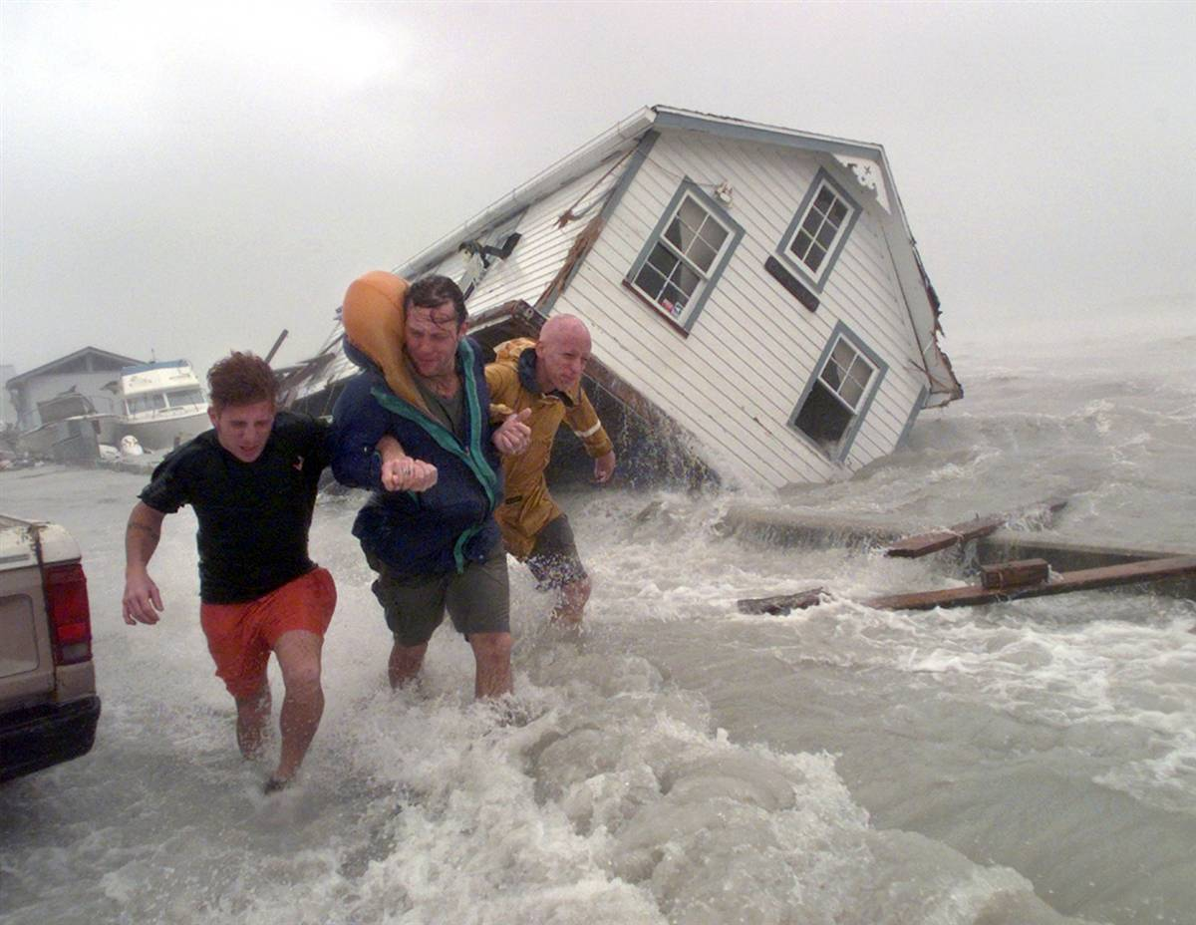
Write down 5 things that you observe in this picture.

Slide 4
Observations:
obtaining information using one or more of your senses
Just the facts

Slide 5
Observations can be very obvious or they may take awhile before they are noticed. Can you find the arrow on the truck?

Slide 6
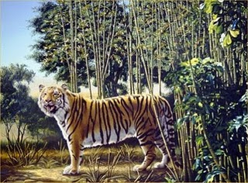

Slide 7
Notes:
Inference Example: You see a boy running down the hall, make an inference. He is late to class. He is running from the principal. He has to go to the bathroom really bad.

Slide 8
Count how many F’s are in the following sentence.

Slide 9
Qualitative Observations:
1. not precise
2. quality of an object
Ex: It is hot.
She is tall.

Slide 10
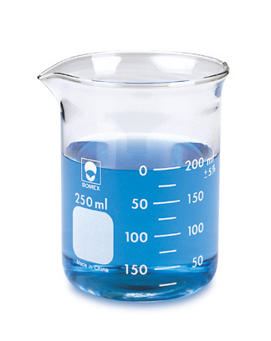
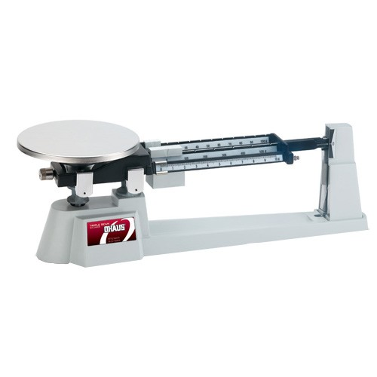
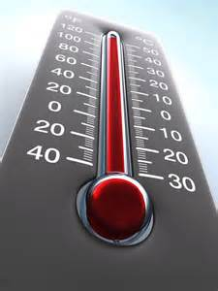
1. Involving a measurement (quantity)
2. Always involves a number
Example: It is 80 degrees.
She is 6 feet tall.
Quantitative Observations:

Slide 11
Number 1-5 on the right side of your cornell notes
1.
2.
3.
4.
5.

Slide 12
Qualitative and Quantitative Observations
Read the following examples and then decide if each is either Qualitative (Qual) or Quantitative (Quan).
Qualitative
1)________________ The candy was sour
2)________________ The slug was slimy
3)________________ The bug was 5 cm long
4)________________ The flower is red
5)________________ The mass of the beaker was 122 g
Qualitative
Quantitative
Qualitative
Quantitative

Slide 13
Inference
A logical conclusion based on observations
many possible interpretations

Slide 14
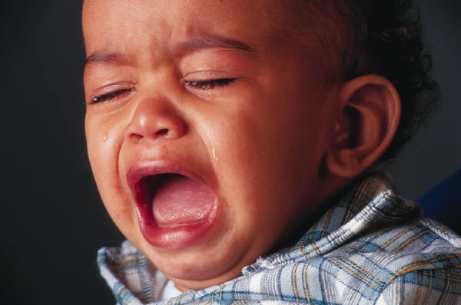

Slide 16
Back of 6

Slide 17
QUALITATIVE QUANTITATIVE
1.
2.
3.
4.
5.

