Slide 1
Natural Selection and Adaptation…54

Slide 2
Theory of Evolution
Species adapt, or change, over time leading to new variations which will result in a new species or the species will become extinct.
Slow

Slide 3
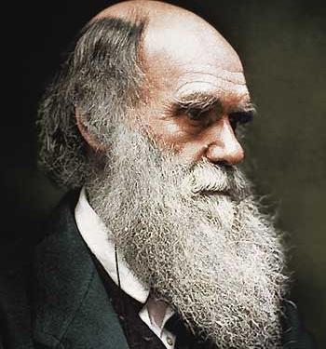
Charles Darwin
The Theory of Natural Selection.
Studied birds in the Galapagos

Slide 4
Galapagos
Darwin made a trip to the Galapagos Islands
Studied animals on each island
Noted differences between the same organisms on different islands
Notes:
Do they know where these islands are?

Slide 5
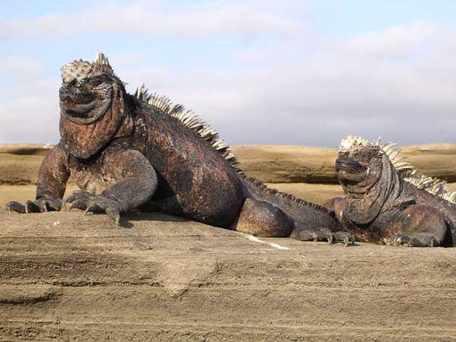
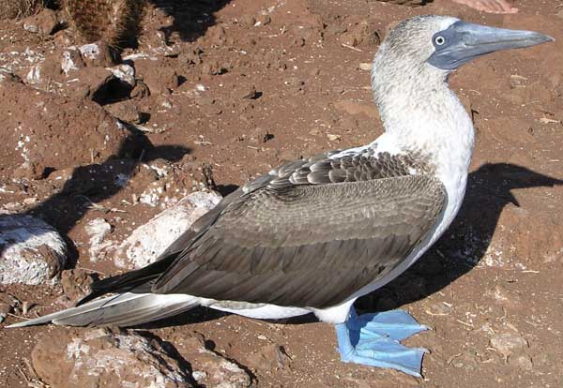
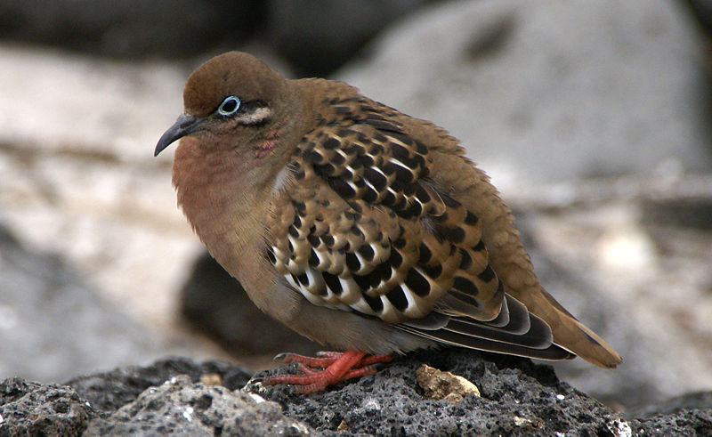
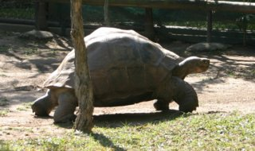
Notes:
Blue footed boobie!

Slide 8
Finches
Noted major differences between the beaks of finches
Thick beaks = eat nuts/fruits
Many nut/fruit-bearing trees
Thin beaks = eat insects
Islands with few nut/fruit-bearing trees

Slide 9
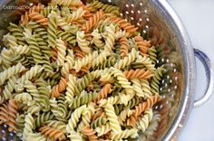
Wacky Mac
What was the most popular pasta color?
What was the least popular pasta color?
3. If the pasta was “worms”, what would eventually happen to the green worms?
4. Which “worm” would survive the longest??

Slide 10
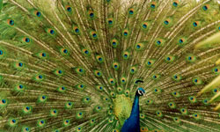
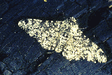
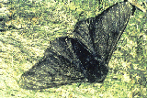
5 points of natural selection
Population have genetic variations
Some variations are favorable.
More offspring are produced than survive
Those that survive have favorable traits (advantageous)
A population will change over time

Slide 11
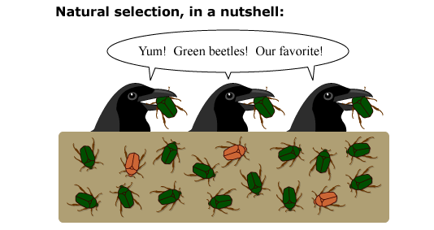

Slide 12
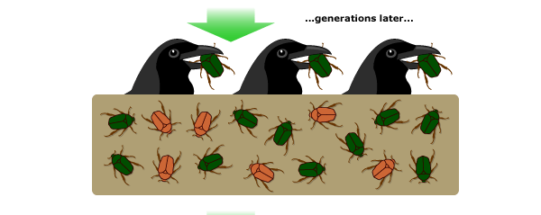

Slide 13
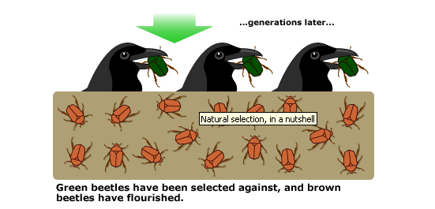

Slide 14
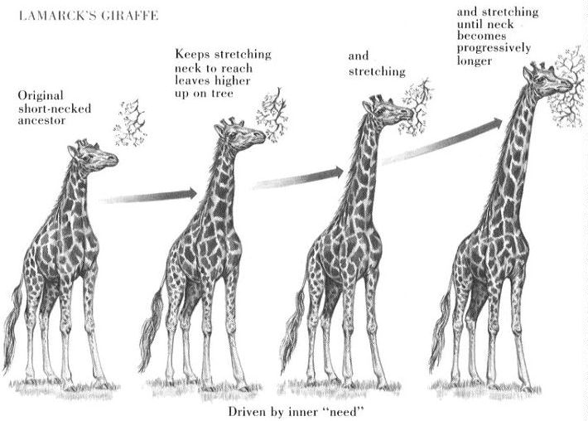

Slide 15
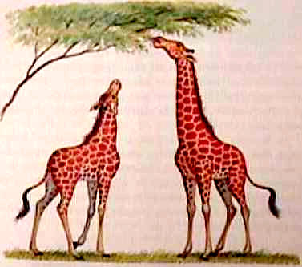
v
GIRL
BOYS

Slide 16
Mutation
Changes in the DNA of organisms
Can be cause by radiation/chemicals or naturally

Slide 17
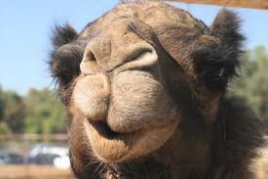
Adaptation
Trait that helps an organism survive in its environment

Slide 18
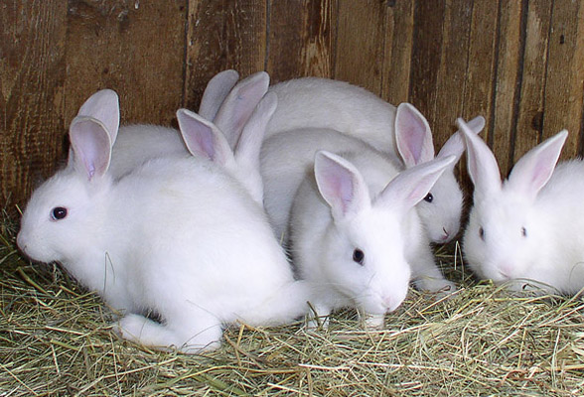
Fitness
How successful an organism is at reproducing.
NOT how long it lives
“Survival of the Fittest” = Survival of those who make a lot of babies
Notes:
This would be an honors only slide

Slide 19
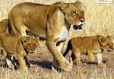
Who is the fittest?

Slide 20
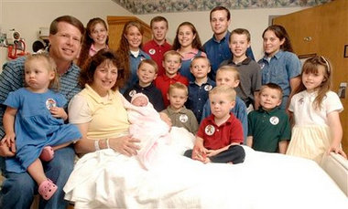
Who is the fittest?

Slide 21
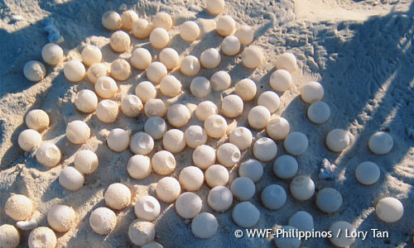
Overpopulation
Have tons of babies at a time
Predators kill most offspring
More babies = more that survive

Slide 22
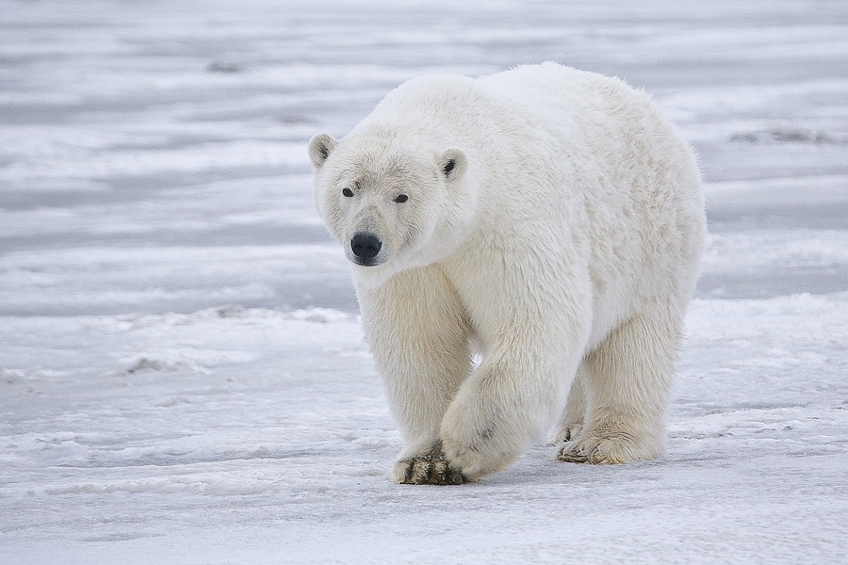
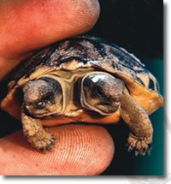
TOP OF THE PAGE
Mutation → New Genetic Trait → advantageous →
passed down to offspring → Evolution!!!
Notes:
I am insistent that they know what DNA is and what happens when you change it – prep for high school

Slide 23
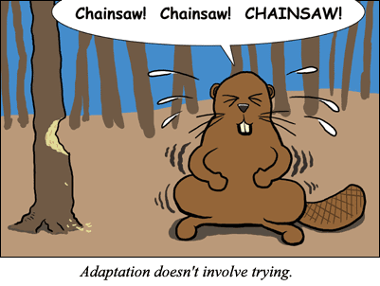

Slide 24
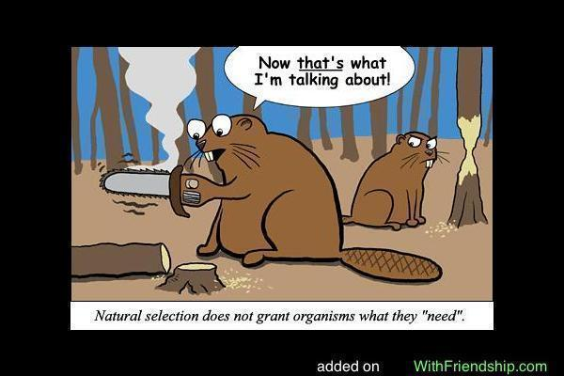

Slide 25
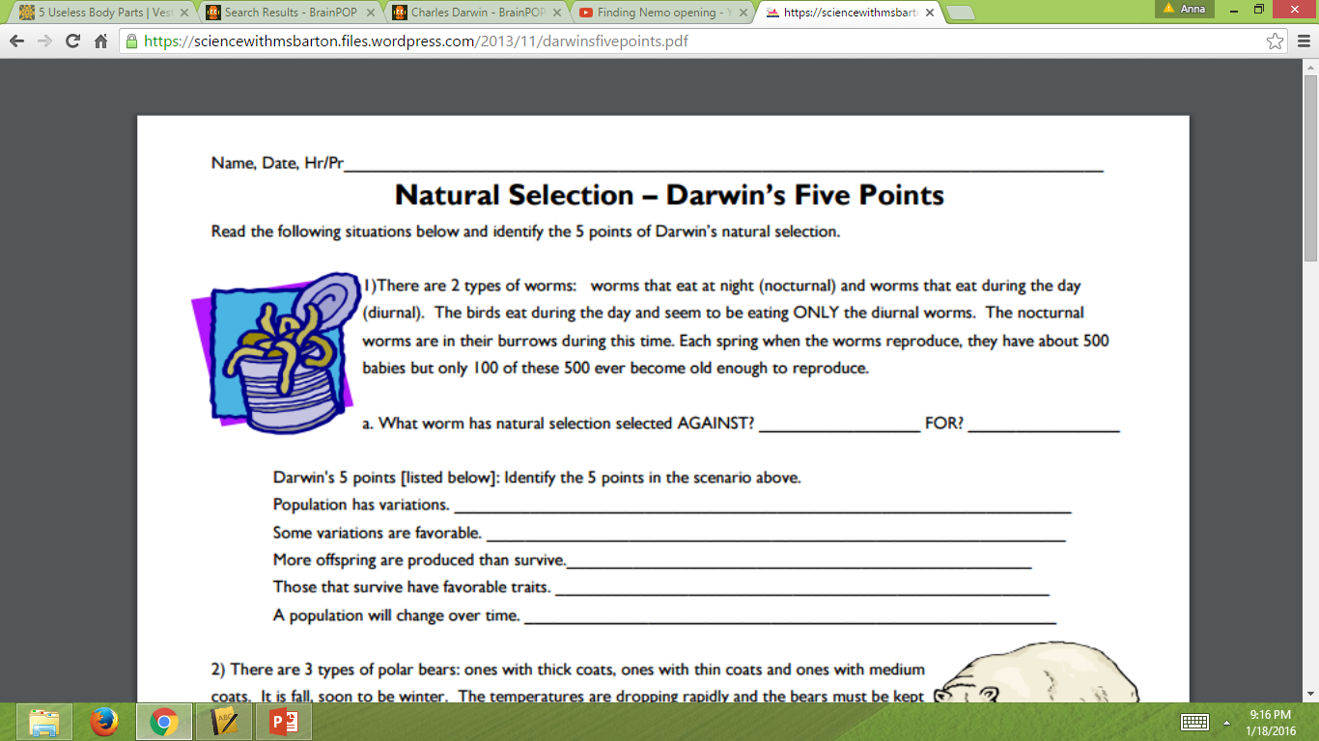
Diurnal Worms
Nocturnal worms
There are 2 types of worms
The nocturnal worm is not getting eaten
The worms produce 500 babies
The nocturnal worms are burrowed underground when the birds are feeding
Eventually there will be no more diurnal worms and only nocturnal worms.

