Slide 1
Metals, Nonmetals and Metalloids…13

Slide 3
WORD
DEFINITION
CHARACTERISTICS
EXAMPLES AND PICTURES

Slide 4
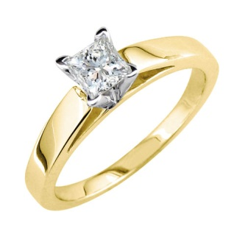
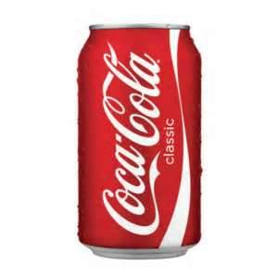
METAL
Metals are elements that conduct electricity and heat
Malleable-can be flattened
Ductile- can be made into a wire
Shiny
High melting point
Magnetic
High density
Iron
Aluminum
Gold

Slide 5
NONMETALS
An element that usually has properties opposite of metal
gas
Easily broken
Dull
Poor conductor of heat and electricity
Neon
Helium
Oxygen

Slide 6
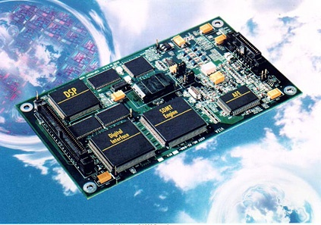
METALLOID
Properties of metals and non metals
Found on zig zag line of the periodic table
Semi conductors
Arsenic
Silicon

