Slide 1
Measuring Mass …3

Slide 2
Measuring Mass …3

Slide 3
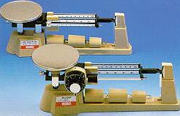
Mass is the quantity of matter (weight)
Instrument-balance/scale
Unit-grams, kilograms, milligrams

Slide 4
Using the balance
1) Place all weights on zero
2) Move largest weight until it tips over, then move it back one space
3) Move smaller weights the same way until balanced
4) Add weights together

Slide 5
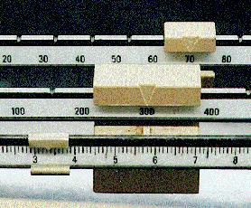
Using the balance
300
70
3.4
_______
373.4 grams

Slide 6
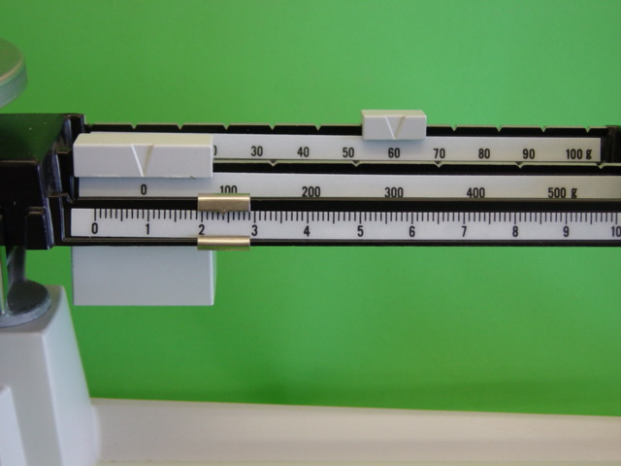
Balance

Slide 7
Object | Mass (g)
Sketch this on the same page as the notes

Slide 8
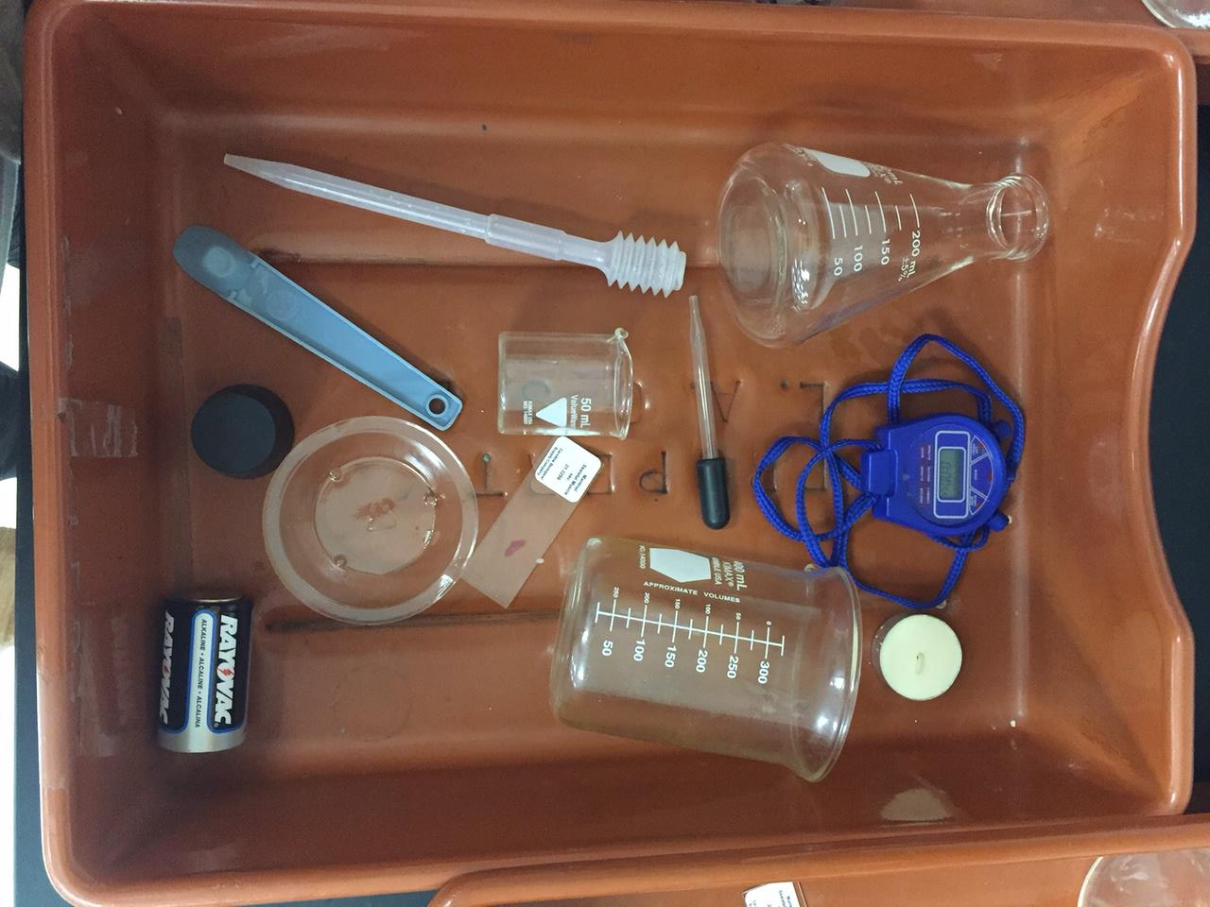
Measuring
stopwatch
flask
candle
eyedropper
Large Beaker
Small Beaker
pipette
Microscope slide
Measuring spoon
Petri dish
Rubber stopper
battery

Slide 9
Object | Mass (g)

Slide 10
Cubes
Cube | Mass | Material
A
B
C
D
E
F
G
H
I
J
Sketch this on the back of page 3

