Slide 1
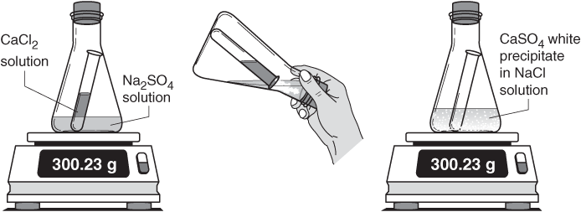
Law of Conservation of Mass…28
The Law of Conservation of Mass states that mass cannot be created or destroyed
What you start with in a reaction is what you will also end with
The reactants and products in a reaction MUST be equal.

