Slide 1
Kingdoms

Slide 2
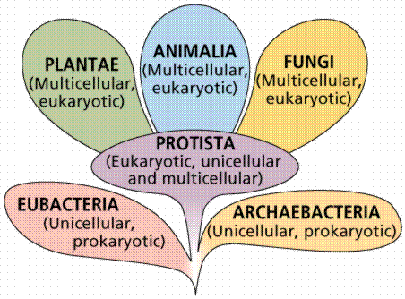
Six Kingdoms of Life

Slide 3
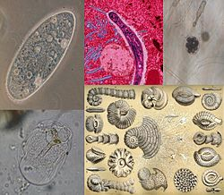
Kingdom | Prokaryote or Eukaryote | Unicellular or multicellular | Autotroph or Heterotroph | Examples
Archeabacteria | Prok | Unicellular | Hetero Autotroph | Bacteria that live in extreme circumstances (Really hot, really cold)
Eubacteria | Prok | Unicellular | Hetero Auto | Bacteria only
Protists | Euk | Unicellular Multicellular | Auto Hetero | Amoeba Paramecium Algae Protozoan

Slide 4
Kingdom | Prokaryote or Eukaryote | Unicellular or multicellular | Autotroph or Heterotroph | Examples
Fungi | Euk | Unicellular Multi | Hetero (absorb nutrients from other organisms) | Mushrooms Molds
Plants | Euk | Multi | Auto | Tree, ferns
Animals | Euk | Multi | Hetero | Tiger Jellyfish Human

