Slide 1
Introduction to the atom

Slide 2
Introduction to atoms…page 11
Attach questions to left side of the paper

Slide 4
Introduction to the ATOM…11
What is matter?
What is an atom?
What is a nucleus?
What is a proton?
What is a neutron?
What is an electron?
What is the atomic number? What is the atomic mass?

Slide 5
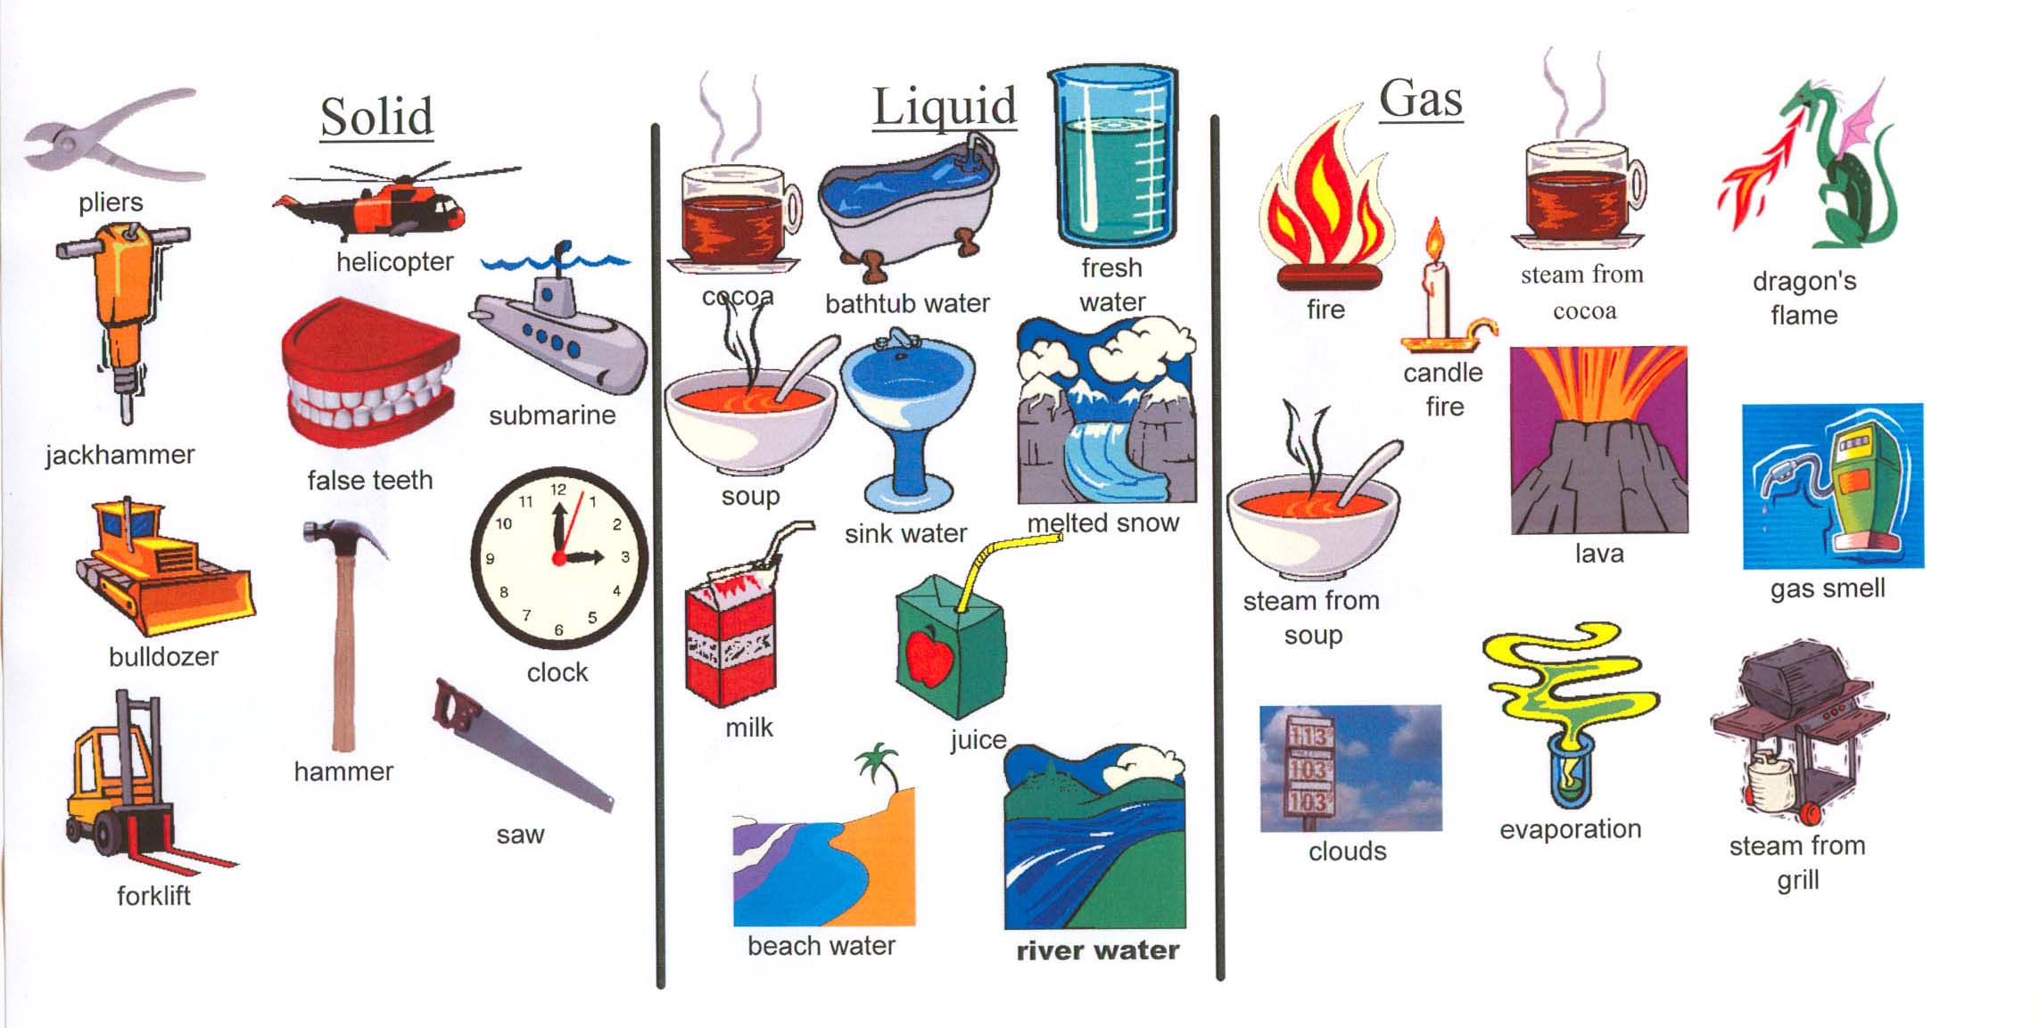
Introduction to the Atom…11
What is Matter?
Anything that has mass and takes up space

Slide 6
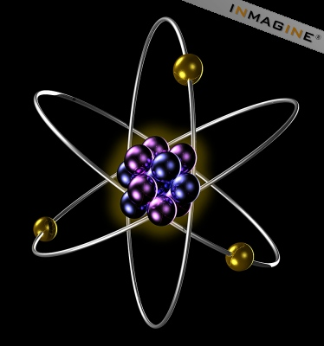
What is an ATOM?
The smallest particle of an element.

Slide 7
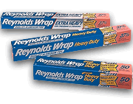
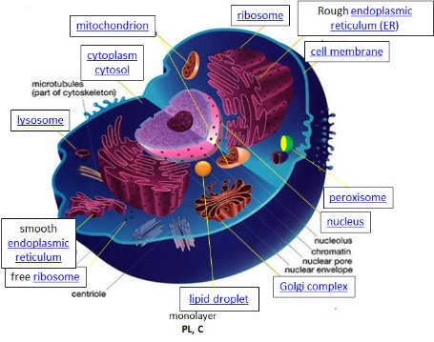
Atoms are so small that…
It would take a stack of about 50,000 aluminum atoms to equal the thickness of a sheet of aluminum foil from your kitchen.
A typical human cell contains roughly 1 trillion atoms.
A speck of dust might contain 3 trillion atoms.
1 trillion atoms →
.

Slide 8
What are atoms made of?
Protons
Neutrons
Electrons

Slide 9
What is the nucleus?
The center of the atom

Slide 10
What atom parts are found in the nucleus?
Protons and Neutrons

Slide 11
What is a PROTON?
A positively charged particle
-
-
-
+
+
+
+
+
+
-
-
+
+
-
+
-
-

Slide 12
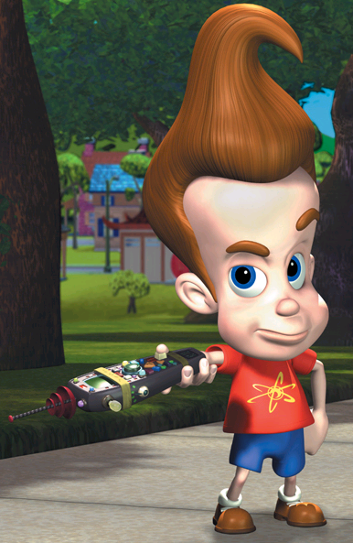
What is a Neutron?
A particle that has no charge (neutral)
Not the same neutron

Slide 13
How do you calculate neutrons?
Neutrons=mass-atomic number

Slide 14
Electron (-)
A negatively charged particle

Slide 15
Where are electrons located?
outside the nucleus
-
-
-
+
+
+
+
+
+
-
-
+
+
-
-
-
-

Slide 16
What is the Atomic Number?
The amount of protons in an element
Every element has a different atomic number

Slide 17
What is ATOMIC MASS?
How much the atom weighs
Protons + Neutrons

