Slide 1
Groups on the Periodic Table

Slide 2
Groups on the Periodic Table…17
Groups – vertical columns
have many similarities
identifies reactivity
Periods – horizontal rows
do not have a lot in common identifies the # of electron shells

Slide 4
KEY…17
Draw key on the front of page 17
Hydrogen
Alkali Metals
Alkaline Metals
Transition Metals
Halogens
Noble Gases

Slide 5
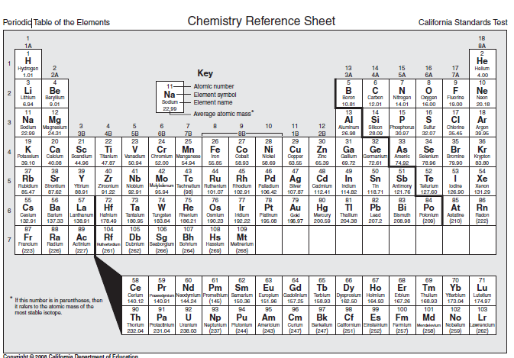
Attach to the front of page 17

Slide 6
Attach to the front of page 17
ALKALI METALS
ALKALINE METALS
HALOGENS
NOBLE GASES
Back of page 17
Front of page 18

Slide 8
GO to my website and click on the link for today’s assignment.

Slide 9
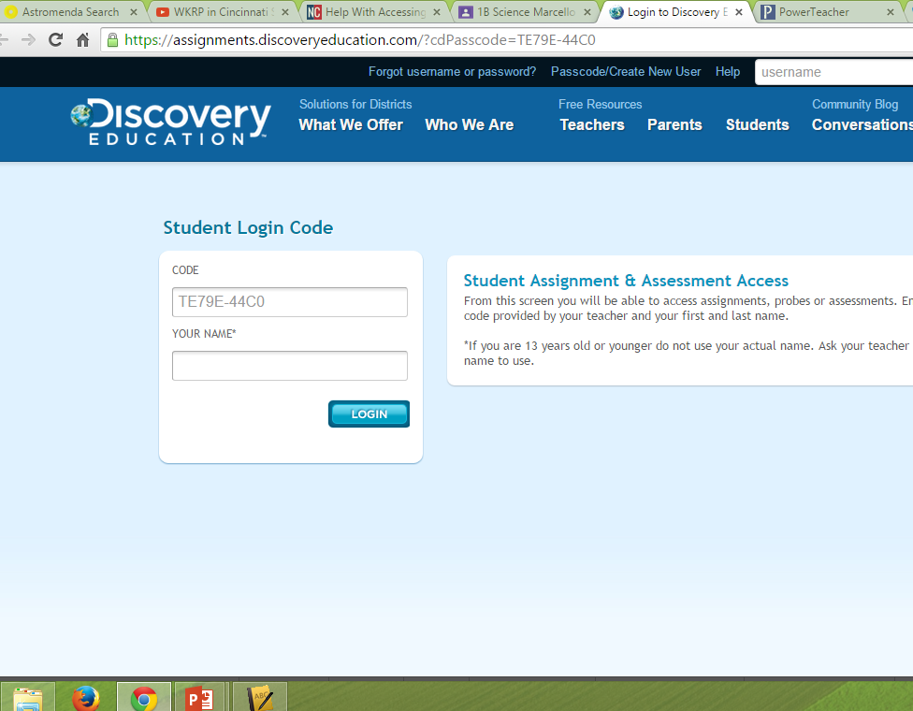
Put your first and last name here

Slide 10
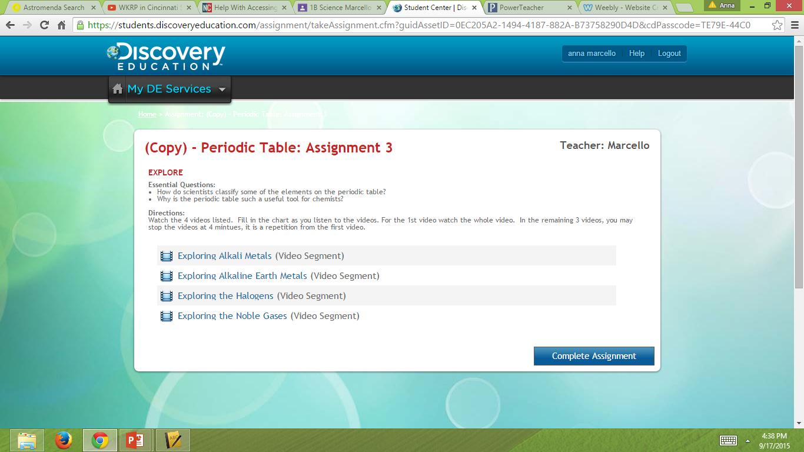

Slide 11
Group number –
Properties-
Examples-
Reactivity-
Valence Electrons-
Uses-

Slide 12
Alkali Metals
Group number – 1
Properties-
Examples-
Reactivity-
Valence Electrons-
Uses-
Soft, tarnish rapidly, low melting point, low density, violently react, silver, conductors
Lithium, sodium, potassium, rubidium, cesium, francium
React violently, very reactive
1
Aircrafts, salt, batteries, explosives

Slide 13
Alkaline Metals
Group number – 2
Properties-
Examples-
Reactivity-
Valence Electrons-
Uses-
Solid
Calcium, magnesium,
Very reactive metals
2
Bones, teeth, light weight metals for bikes/airplanes

Slide 14
Halogens
Group number – 17
Properties-
Examples-
Reactivity-
Valence Electrons-
Uses-
Non metal
Helium, argon, neon, xenon, krypton
Very reactive non metals
7
Used to kill bacteria/germs

Slide 15
Noble Gases
Group number – 18
Properties-
Examples-
Reactivity-
Valence Electrons-
Uses-
Gases, non metals
Helium, argon, neon, xenon, krypton
Not reactive
8
Balloons, lights

Slide 16
Transition Metals
Group number – 3-12
Properties-
Examples-
Reactivity-
Valence Electrons-
Uses-
Great conductors, high melting point, hard
Copper, silver, gold, titanium
Less reactive than most metals
1,2
Coins, jewelry

