Slide 1
Groups of the Periodic Table

Slide 2
CONCLUSION…front of 13
DO NOT COPY THE QUESTIONS
Why is “shape” not a good test for determining if an element is a metal or a nonmetal?
You have been asked to design a new coffee cup for Starbucks. Describe what type of materials (metals, nonmetals and/or metalloids) you would use and why.
Compare and contrast metals and nonmetals. (choose the method-Venn diagram, chart, sentences)

Slide 3
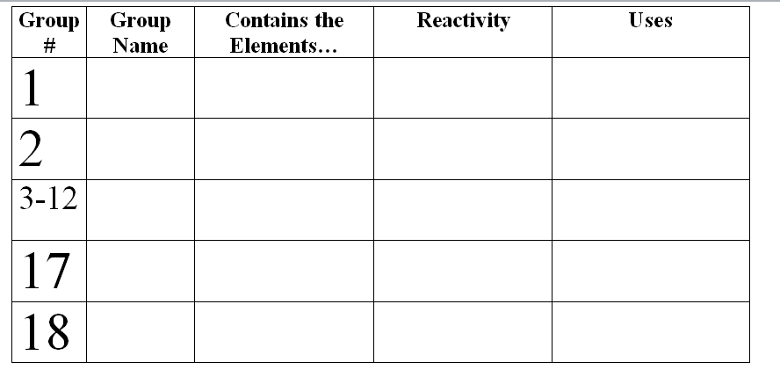
Groups on the Periodic Table…14
Copy chart on the front of page 14

Slide 4
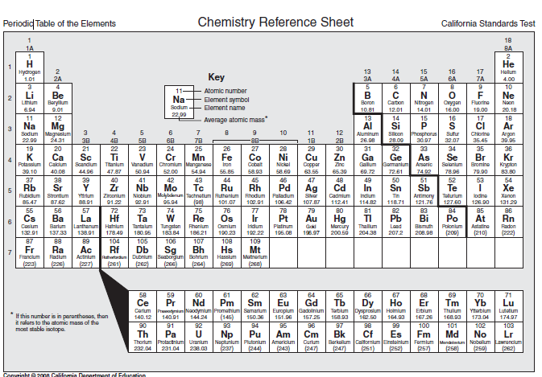

Slide 5
Back of 14
Groups-
Vertical column on the periodic table
Groups have similar properties
Periods-
a horizontal row on the periodic table.
Elements have different properties

