Slide 1
Energy Sources

Slide 2
NONRENEWABLE
RESOURCES

Slide 3
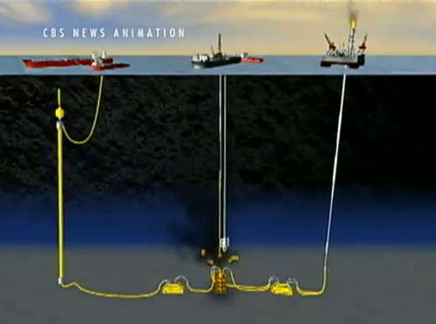
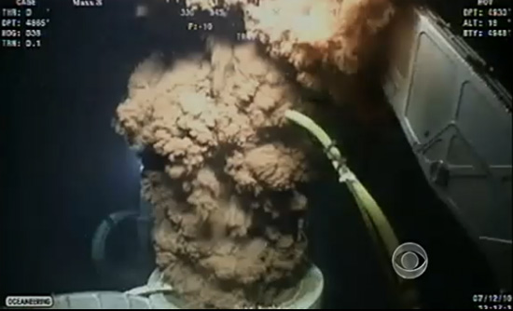
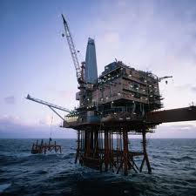
OIL/GASOLINE
ADVANTAGES
All our transportation relies on gas/oil (cars, planes)
Cheap
CONS
environmental hazards
Political conflict
BP oil spill *
Brainpop fossil fuels
1 year later *
Brainpop gas and oil

Slide 4
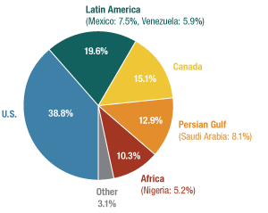

Slide 5
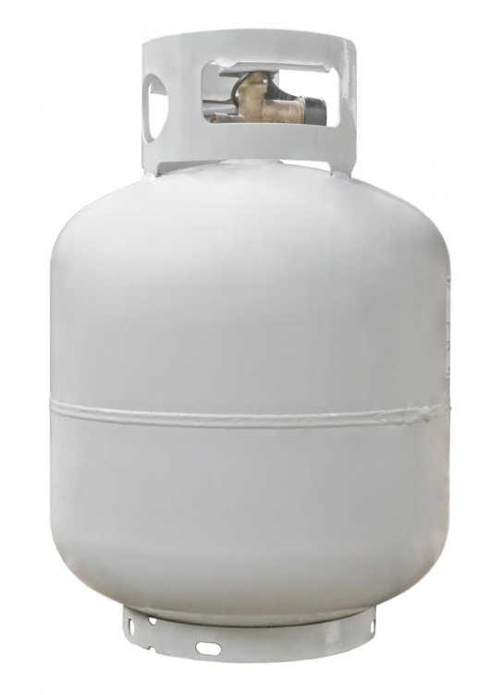
NATURAL GAS
ADVANTAGES
Cheap
Portable
Burns clean
CONS
Carbon Dioxide---global warming
Affects wildlife

Slide 6
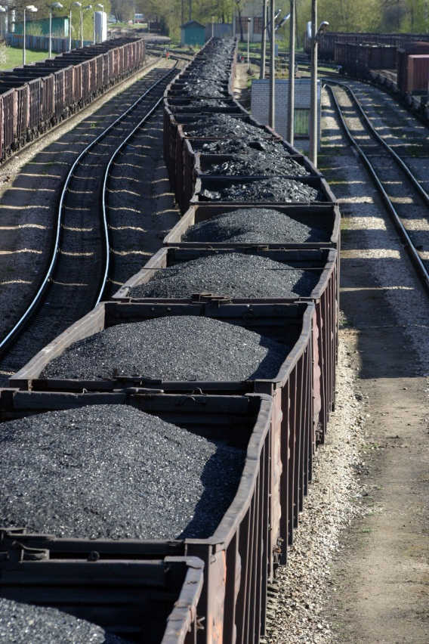
COAL
ADVANTAGES
Cheap
Easy to transport
CONS
Mining is dangerous
Releases CO2
Mining recue
Mining recue

Slide 7
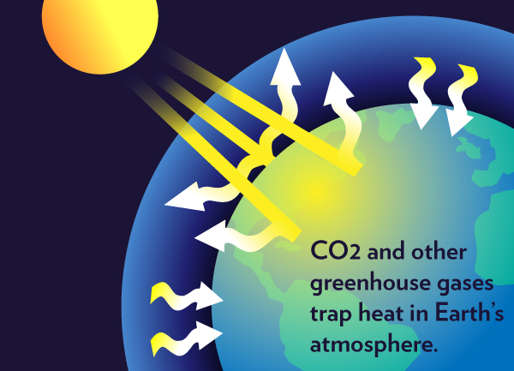
Greenhouse effect is good because it causes our earth to be warm enough to live on.
But it is bad because the Earth is getting warmer and warmer causing changes in weather patterns and snow melting.

Slide 8
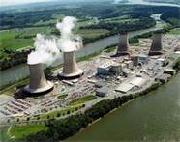
NUCLEAR (Uranium)
ADVANTAGES
Cheap
Little pollution
CONS
Hazardous nuclear waste (meltdown)
$$$ to build power plants
Nuclear meltdown
Nuclear Energy Brainpop

Slide 9
RENEWABLE
RESOURCE

Slide 10
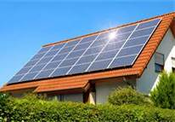
SOLAR
DISADVANTAGES
Photovoltaic Cells are expensive
only works during sunlight
ADVANTAGES
Doesn’t require extra land
no pollution
SOLAR POWER Cartoon
Brain Pop Solar

Slide 11
GEOTHERMAL
ADVANTAGES
no pollution
DISADVANTAGES
Only works in certain areas
Can’t be transported
Heating a house
Chevron

Slide 12
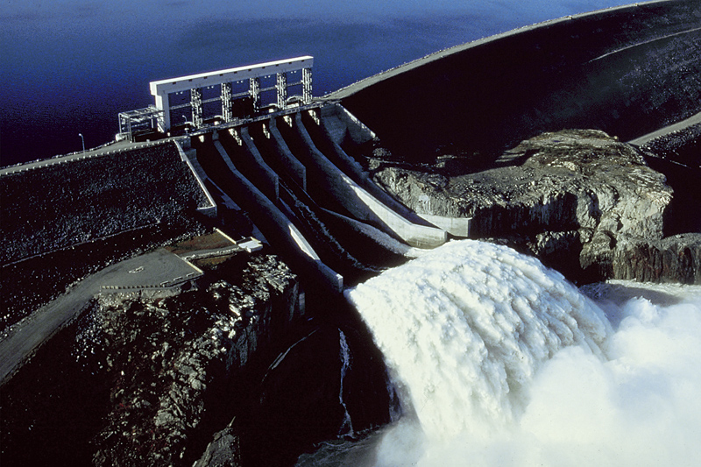
HYDROPOWER
PROS
Cheap
No pollution
DISADVANTAGES
Dams are harmful to wildlife in ecosystems
Dams are $$$ to build
Brain POP Dams

Slide 13
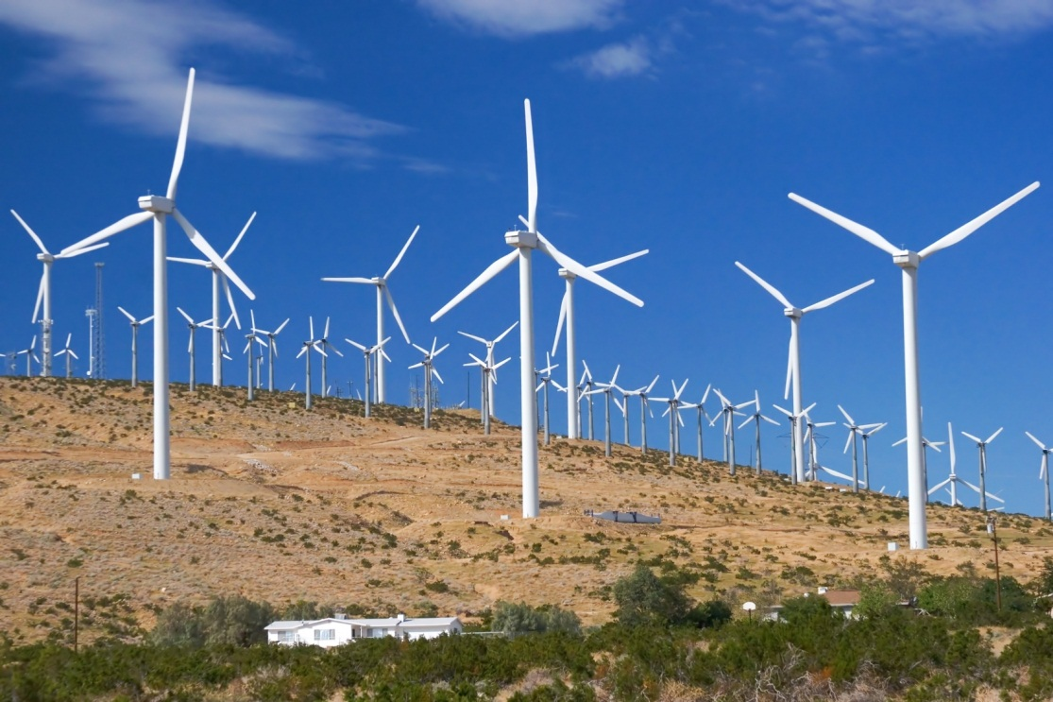
WIND POWER
ADVANTAGES
No pollution
DISADVANTAGES
Noisy
Dangerous for birds
$$$$ to put up “wind farm”
BrainPop Wind

Slide 14
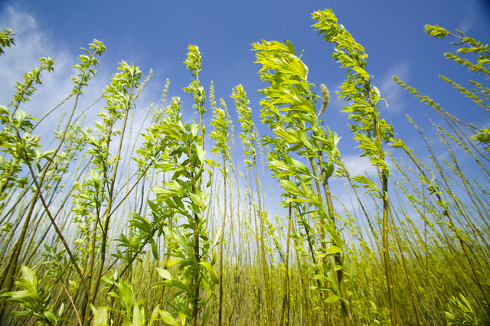
BIOMASS *
ADVANTAGES
Burns materials normally thrown away
DISADVANTAGES
Biomass needs to be replaced
Air pollution when burned
trees
BrainPop Biofuels

