Slide 1
Compounds and Mixtures

Slide 2
Compounds…23
Compounds
Examples of compounds
A pure substance made up of 2 or more elements chemically combined
NaCl – salt
H₂O- water
C₆H₁₂O₆-sugar

Slide 3
Compounds have different properties than the elements that make them up
Salt –
Sodium-
Chlorine-
Water-
Hydrogen
Oxygen-
Edible, safe
Explosive
poisonous
Non flammable liquid
Flammable gas
Flammable gas

Slide 4
Chemical Formula
Subscript-
a chemical symbol that represents the element and the number of atoms
a number written below and to the right of the symbol
H20
subscript

Slide 5
Compounds Form using definite ratios of elements
H₂O-water
H₂O₂-peroxide
CO- carbon monoxide (car exhaust)
CO₂-carbon dioxide

Slide 6
Compounds can be broken down
It’s Difficult
Can only be broken down using a chemical change (electrical current, fire)

Slide 8
Oxygen yellow
Sodium green
Potassium orange
Carbon red
Hydrogen White
Sulfur blue

Slide 9
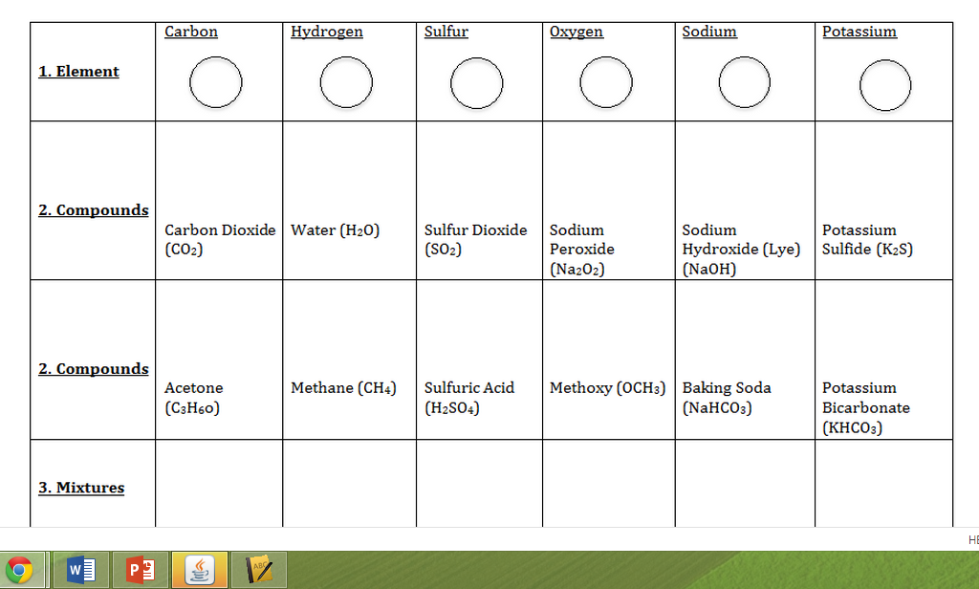

Slide 10
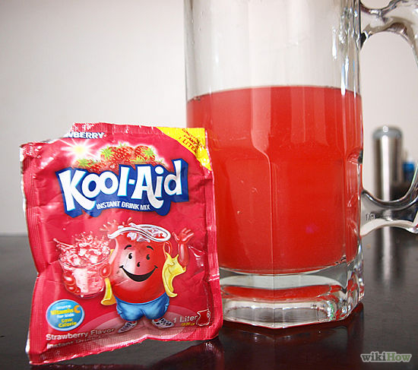
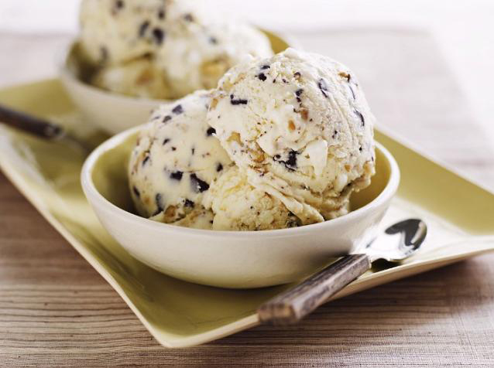
Mixtures…back of page 23
Combination of two or more pure substances that are NOT chemically combined
Ex. Sugar and water
NaCl + H20
No specific Ratio
The parts retain their identity

Slide 11
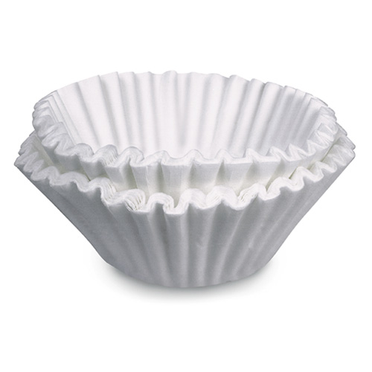
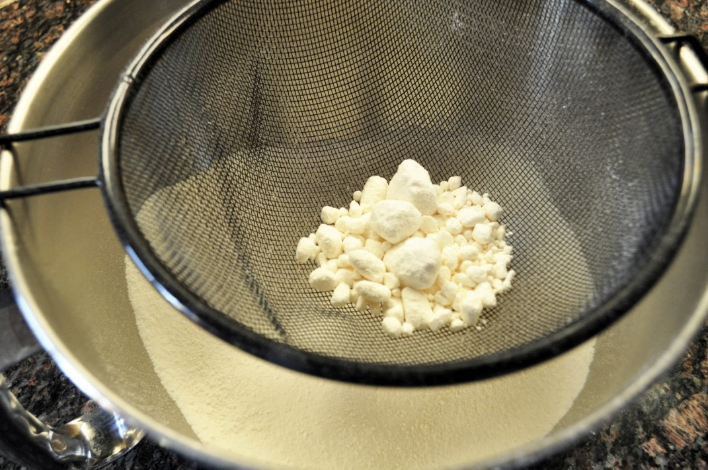
Easily separated(filtration, evaporation, sifting)

Slide 12
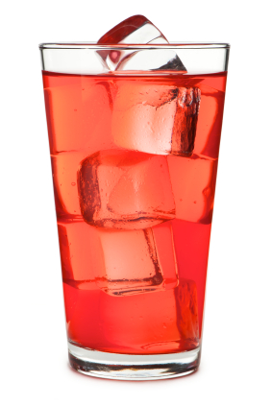
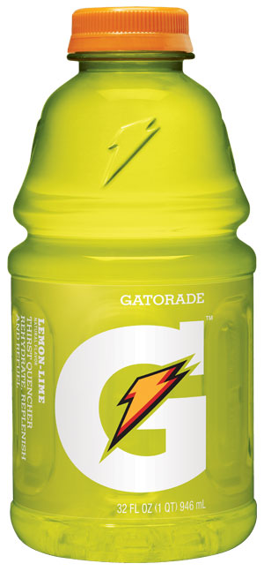
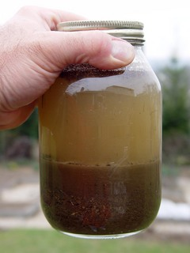
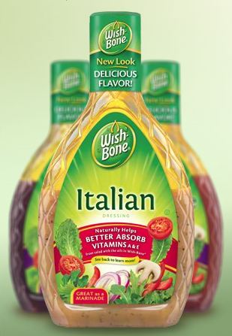
Two types of Mixtures
Homogeneous – looks like one substance (ex. Kool aid, soda)
2. Heterogeneous – looks like two things mixed together (sand and water, Italian dressing, pizza)

