Slide 1
CELLULAR RESPIRATION
PHOTOSYNTHESIS
How do cells get energy?

Slide 2
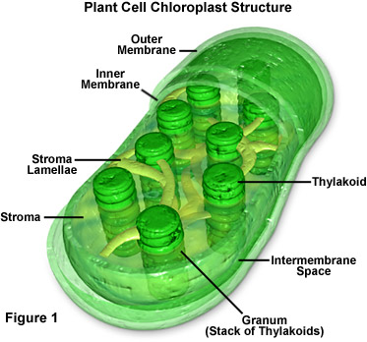
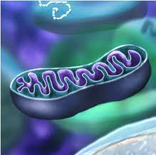
Reactants
Carbon dioxide
Water
Energy
Product
glucose/sugar
Oxygen
Reactants
Oxygen
Glucose
Products
Carbon dioxide
Water
ENERGY
MITOCHONDRIA
CHLOROPLAST

Slide 3
Photosynthesis:
Formula:
CO₂ + H₂0 + energy C₆H₁₂O₆ + O₂
Plants Only!

Slide 4
Cellular Respiration:
Formula:
C₆H₁₂O₆ + O₂ CO₂ + H₂0 + ENERGY
Plants and animals undergo CR for ENERGY!

Slide 5
Cellular Respiration:
Formula:
C₆H₁₂O₆ + O₂ CO₂ + H₂0 + energy
Photosynthesis:
Formula:
CO₂ + H₂0 + energy C₆H₁₂O₆ + O₂

Slide 6
Attach to back of 73
Dot dot not a lot!!!!!!!!!!!!

