Slide 1
Acids and Bases..95

Slide 2
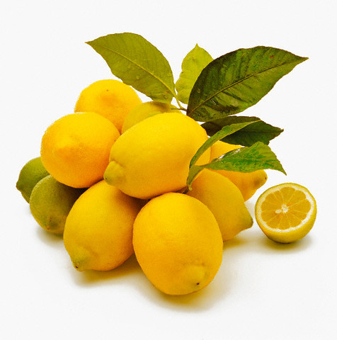
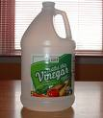
ACIDS
Sour
Starts with H(hydrogen)
Can burn skin
Examples- Orange juice, lemons, vinegar, HCl, H₂SO₄

Slide 3
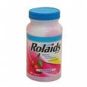
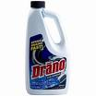
BASES
Bitter
Slippery
End with an OH (hydroxide)
Burns
Examples-Drano, cleaning products, antacid, KOH, MgOH

Slide 4
pH
an indicator changes colors to tell how acidic or basic a solution is.
1-6 is an ACID
7 is NEUTRAL (water)
8-14 is a BASE

